Slide 1
BTech Final Seminar
HTML1st- A lightweight dynamic web
Boyang tang

Slide 2
Presentation Outline
Project Goal
Issue Review
Plan of Second Semester
Implementation
Testing & Evaluation
Conclusion

Slide 3
Project Goal
Project is to develop a light-weight C# engine that handles server-side scripting
The engine will convert HTML pages with embedded C# code fragments to pure HTML pages

Slide 4
Issue Review
Work have done in first semester:
Find a good HTML Parser (based on HTML Agility Pack)
Treat C# like a Scripting language
Compile assemblies on the fly and invoke a type’s method at runtime by using reflection in .NET
Issue of HTML Agility Pack:
This is an agile HTML parser that supports XPATH expression
Previously, the C# code fragments were enclosed within <??> and regarded them as Processing Instructions (PIs).
HTML Agility Pack can not identified those PIs.

Slide 5
Second Semester
Second plan :
Introducing a new tag like <sourceCode> into HTML file instead of enclosing C# fragments within <? ?>
Then, the new format looks like < sourceCode > C# fragment < /sourceCode >
Can also add an attribute for each element:
< sourceCode class = “html1st” > function(); < /sourceCode >

Slide 6
Project Implementation
External Libraries
Parsing HTML files with embedded C# code fragments
Using the compiled code
Producing pure HTML files
Optimization Design

Slide 7
Project Implementation
External Libraries
Parsing HTML
HTML Agility Pack
This third-party library which is already commonly used for parsing HTML.
It is very tolerant with "real world" malformed HTML.
An issue: some symbols such as “<”, “>”, and “&” should be escaped in HTML, thereby writing them as “&lt;”, “&gt;”, and “&amp;” instead
Before you can execute the code, you need to reverse those changes
To fix this issue by using WebUtility.HtmlDecode method

Slide 8
Project Implementation
Using the compiled code
Producing pure HTML
a C# class file named “MyOwnMethods” which contains implementations of all customer methods that refer to extracted code fragments.
Once the above code complied into an assembly and then using reflection to invoke each method and execute it at run time
Collect all return values
which means this engine enables to re-edit HTML and replace certain texts inside it
replacing those fragments by return values, and generating a pure HTML file in the end.

Slide 9
Project Implementation
Optimization
Drawback of my program:
--my program depends on a third party library
--not self-independent, external dependency sometimes brings with it a legal security risk
-- add cognitive overhead to the project by requiring new developers to understand additional framework
It is better and safer if we base our work on existing standard library package, then we use XML parser with XPath to parse html files

Slide 10
Testing & Evaluation
Test cases:
Just do some print methods, see whether code fragments can be replaced by strings of running those methods
Work out the sum or division of two random methods
Work out factors of a random number
Work out Boolean method with parameters such as “>” or “<”
-- in order to test whether HTML1st can handle special symbols

Slide 11
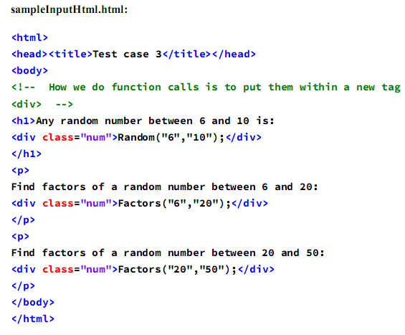
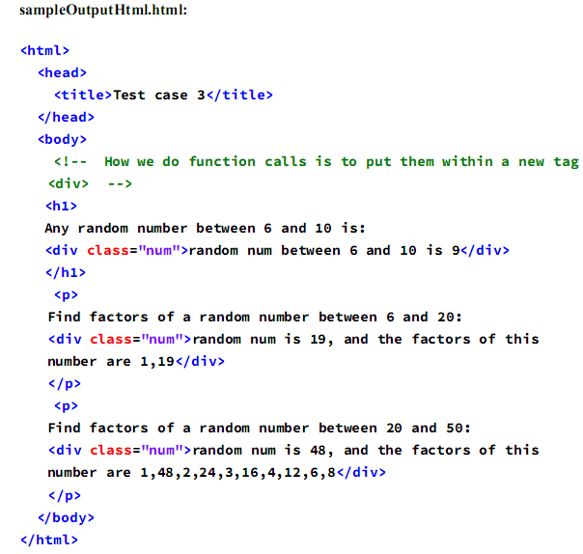
Testing & Evaluation

Slide 12
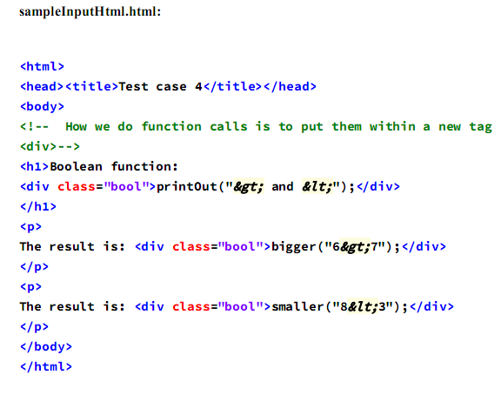
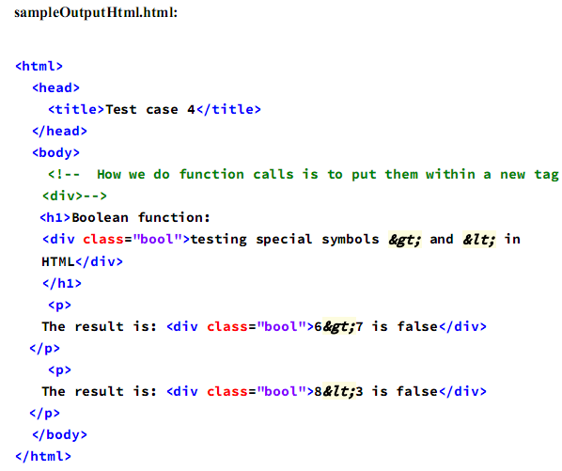
Testing & Evaluation

Slide 13
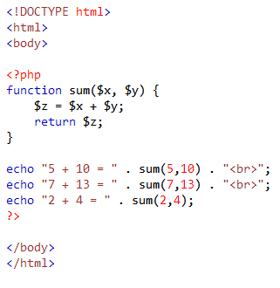
Why do we need HTML1st ?
Nowadays, for making dynamic and interactive Web pages, PHP is a wildly used and powerful tool, but why also do we need another approach such as HTML1st ?
PHP is not light-weight, someone can not see the contents if without running the PHP script, and it is too costly or time-consuming for people to write such a lot of script when making Web pages
Not suitable for large applications
Security issue : Since it is open sourced, so all people can see the source code, if there are bugs in the source code, it can be used by people to explore the weakness of PHP

Slide 14
Conclusion
HTML1st engine is light-weight and it is efficient to handle server-side scripting therefore giving a great of conveniences for making dynamic Web pages
The results of testing show that my program is satisfied all requirements of this project
Personally, I think the HTML1st is potential to be wildly used in the real world or used as a foundation of other developments
The accuracy and effectiveness of this engine to fulfil the task may be limited by the lack of realistic work for large scale experimentation
There may have some other drawbacks or bugs which are not mentioned and can be improved in the future.

Slide 15
Thank You

